Slide 1
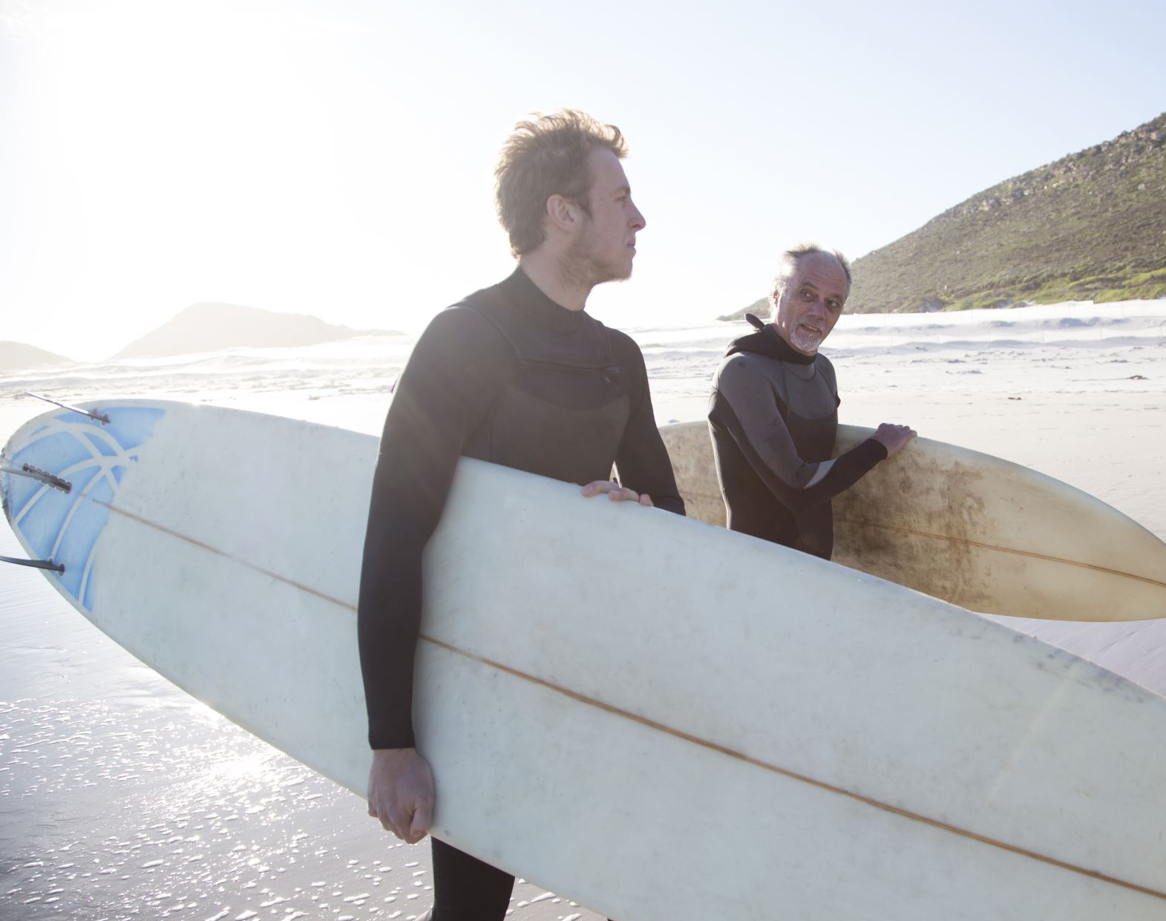
PERTEMUAN PERDANA
BIPA KOREA
13 SEPTEMBR 2021

Slide 2

TOPIK KULIAH PERDANA
MATERI BIPA
PENGAJAR BIPA KOREA
JADWAL & DURASI PERTEMUAN
POLA PEMBELAJARAN
KEHADIRAN & PENILAIAN
TATA TERTIB BIPA DARING
SEKILAS TEMA LEVEL 1 & LEVEL 2

Slide 3

Materi BIPA
Level
BIPA 1
BIPA 2
BIPA 3
BIPA 4
BIPA 5
BIPA 6
BIPA 7

Slide 4
비파 선생님 소개

Slide 5
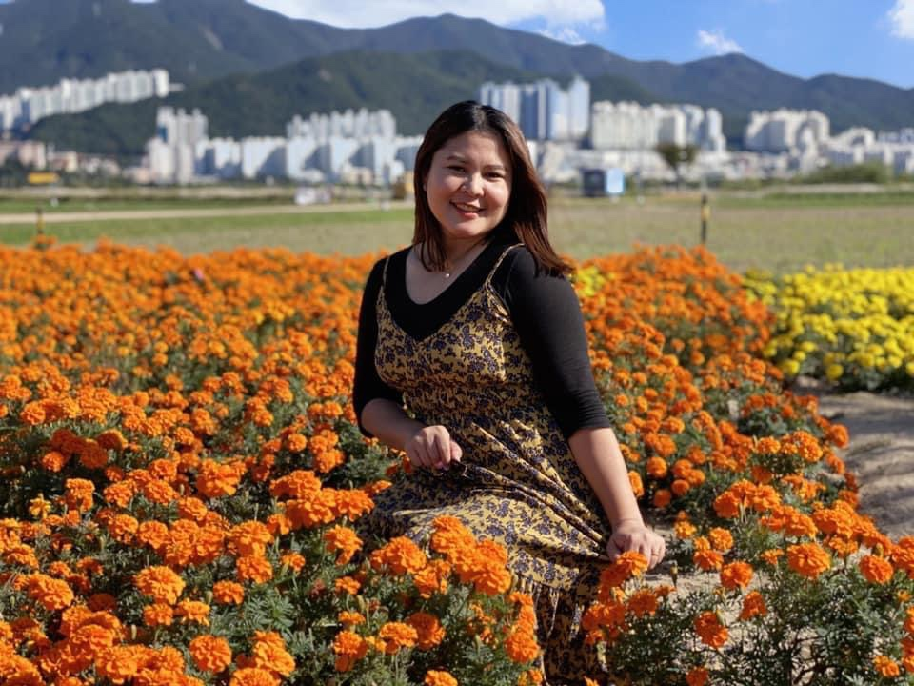
리타 선생님
비파 그룹:
A (월 & 금 :19.00 – 21.00)
D (화 & 목 : 19.00 – 21.00)

Slide 6
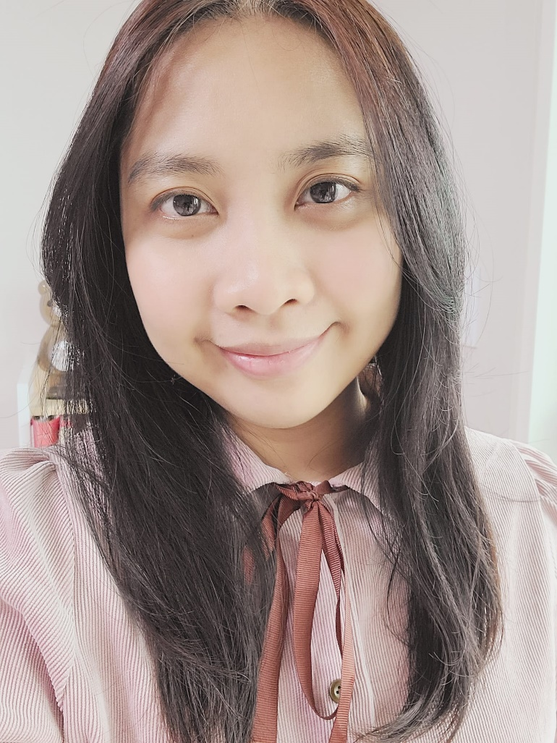
리끄 선생님
비파 그룹:
A (월 & 금 : 19.00 – 21.00)
B (화 & 목 : 10.00 – 12.00)
C (화 & 목 : 15.00 – 17.00)
D (화 & 목 : 19.00 – 21.00)
F (화 & 금 : 15.00 – 17.00)
K (토 & 일 : 17.00 – 19.00)

Slide 7

니다 선생님
비파 그룹:
B (화 & 목 : 10.00 – 12.00)
F (화 & 금 : 15.00 – 17.00)

Slide 8
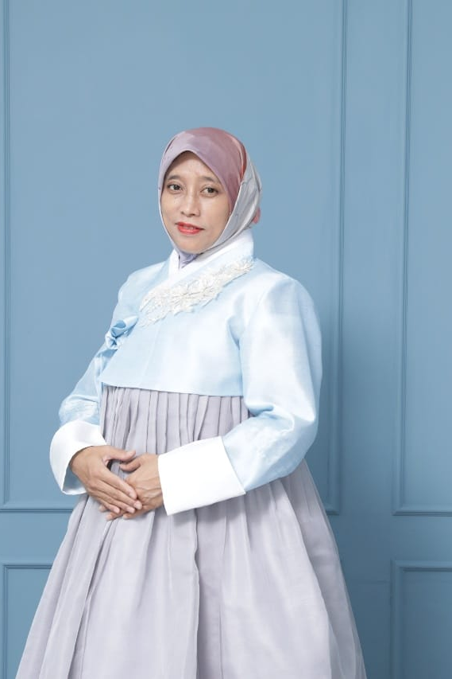
안나 선생님
비파 그룹:
D (화 & 목 : 19.00 – 21.00)
J (토 & 일 : 14.00 – 16.00)

Slide 9
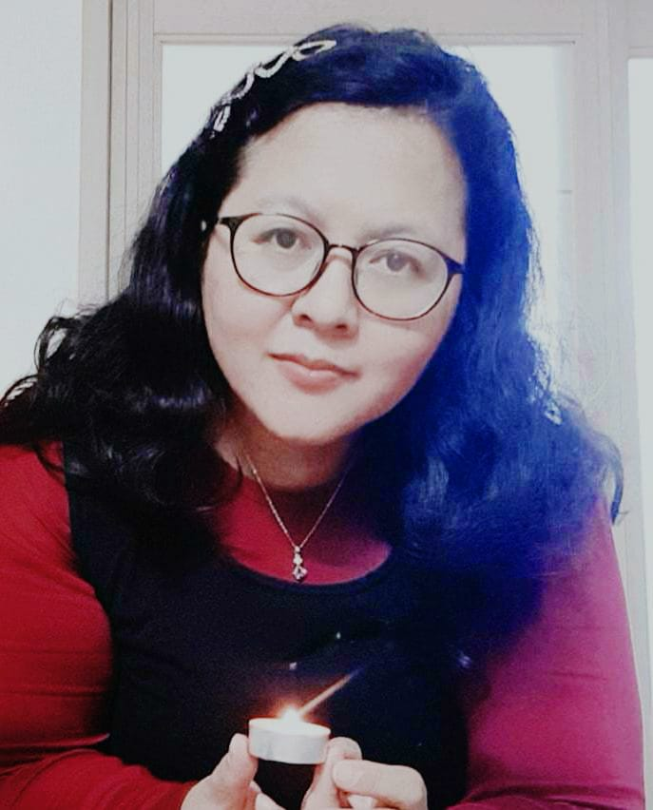
이카 선생님
비파 그룹:
E (화 & 목 : 10.00 – 12.00)
G (화 & 목 : 19.00 – 21.00)

Slide 10
JADWAL DAN DURASI PERTEMUAN
Group | SENIN | JUMAT | LEVEL I | LEVEL 2
A | 19.00 - 21.00 | 19.00 - 21.00 | LITHA (A.1)
 |  |  | RIEKE (A.2)
 | SELASA | KAMIS
B | 10.00 - 12.00 | 10.00 - 12.00 | NIDA | RIEKE (Level 2)
C | 15.00 - 17.00 | 15.00 - 17.00 | RIEKE
D | 19.00 - 21.00 | 19.00 - 21.00 | LITHA | RIEKE (Level 2)
 | 19.00 - 21.00 | 19.00 - 21.00 | ANNA
 | SELASA | JUMAT
E | 10.00 - 12.00 | 10.00 - 12.00 | IKA
F | 15.00 - 17.00 | 15.00 - 17.00 | RIEKE
 | 15.00 - 17.00 | 15.00 - 17.00 | NIDA
G | 19.00 - 21.00 | 19.00 - 21.00 | IKA
 | SABTU | MINGGU
J | 14.00 - 16.00 | 14.00 - 16.00 | ANNA
K | 17.00 - 19.00 | 17.00 - 19.00 | RIEKE
Setiap group;
Masuk 2x seminggu
Durasi belajar 2 jam setiap kali pertemuan
Jika ada perubahan jadwal Pengajar akan mengkomunikasikan ke peserta BIPA

Slide 11
Pola Pembelajaran
Media pembelajaran dengan:
-zoom meeting
-LMS/google classroom
-Group kakaotalk

Slide 12
Kehadiran & Penilaian
Kehadiran harus penuh selama 16 x pertemuan
Penilaian dilakukan di tengah dan akhir semester
Sertifikat akan diberikan kepada peserta BIPA dengan kehadiran minimal 80% dan nilai 75

Slide 13
Tata-tertib BIPA Daring
Kamera harus selalu on,
Mic off kecuali diijinkan,
Raise hand jika ada pertanyaan, belum bicara sebelum diijinkan
Baju sopan dan rapi,

Slide 14
Lomba Kemahiran Bahasa
Pidato
Jurnalis/Presenter
Pantun
Stand up Comedy
Video pendek

Slide 15
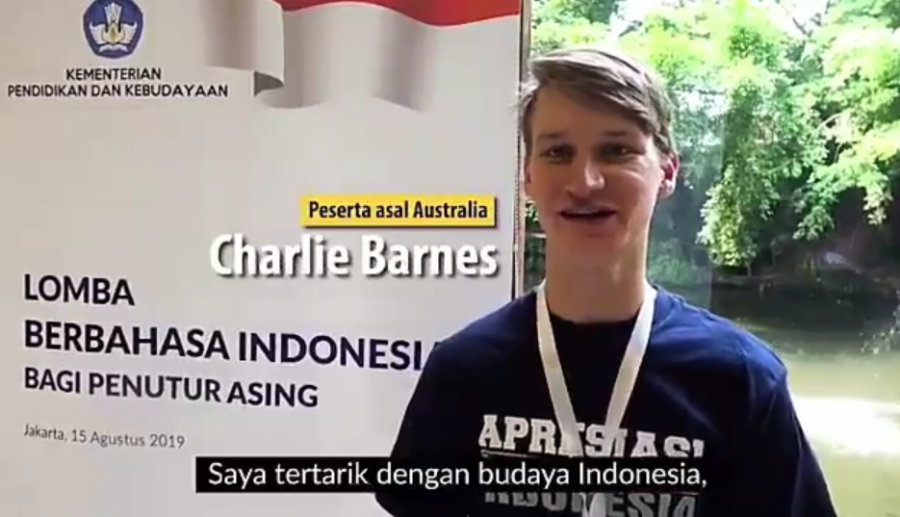
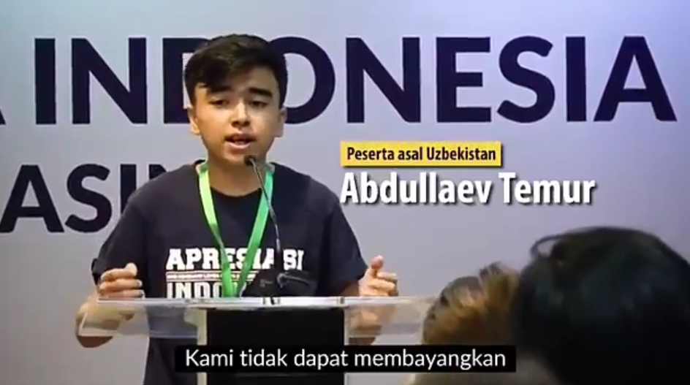
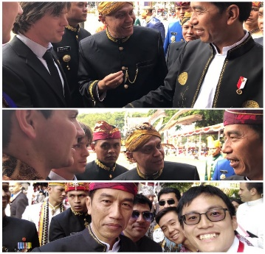
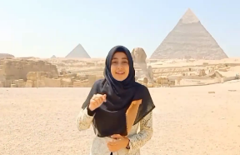
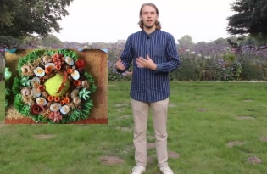
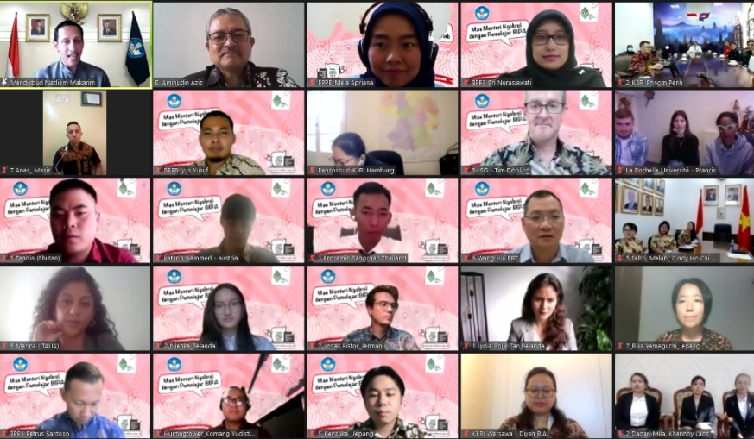
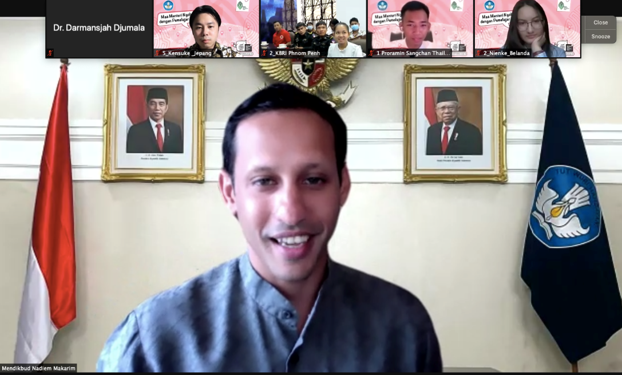
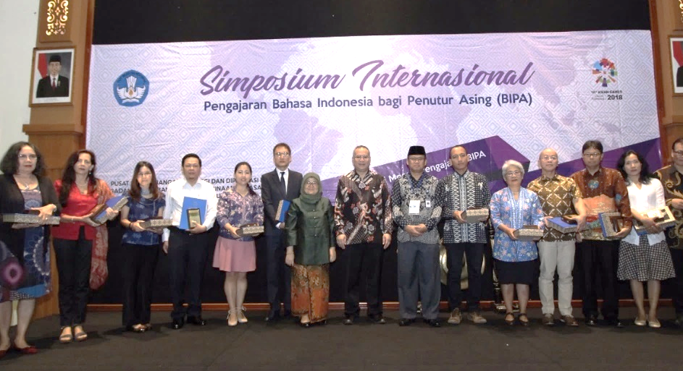
BIPA ACTIVITIES AROUND THE GLOBE
Appreciation and competition on BIPA
Indonesian Handai Festival (Art performance in Bahasa Indonesia)
Indonesian Language Competition and Storytelling for Foreign Speakers
Contests and competitions for BIPA teachers and activists
Appreciation for BIPA activists and language diplomacy activists
BIPA Scientific Meeting and Technical Workshop
Organizing BIPA scientific meetings in Indonesia and abroad
Workshop of implementing BIPA program for BIPA teachers and instructors in Indonesia and abroad

Slide 16
Sekilas Tema Level 1 & Level 2

Slide 17
TERIMA KASIH

Slide 18
Petugas
Pembukaan: Pak Atdikbud
Slide 1 (Materi BIPA): Litha
Slide 2 (Pengajar BIPA): Anna
Slide 3 & 4 (Jadwal & Durasi, Pola Pembelajaran): Ika
Slide 5 (Kehadiran & Penilaian, Tata Tertib): Nida
Slide 6 (Lomba Kemahiran Bahasa): Litha
Slide 7 (Sekilas Tema Level 1 & 2): Rieke
Penutupan: Pak Atdikbud

